Slide 1

Software Testing

Slide 2

What is a Software?

Slide 3
What is a Software?
Software is a collection of programs and data that tell a computer how to work.

Slide 4
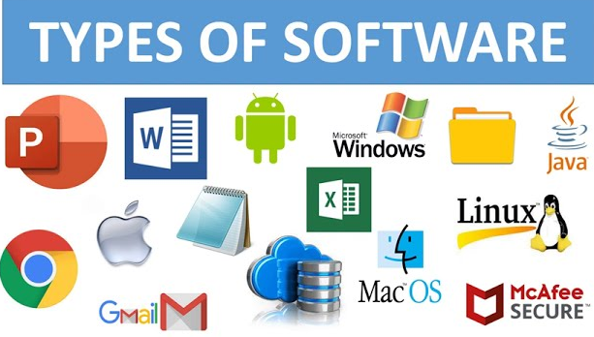

Slide 5



Desktop-based Applications
Mobile Applications
Web Applications

Slide 6
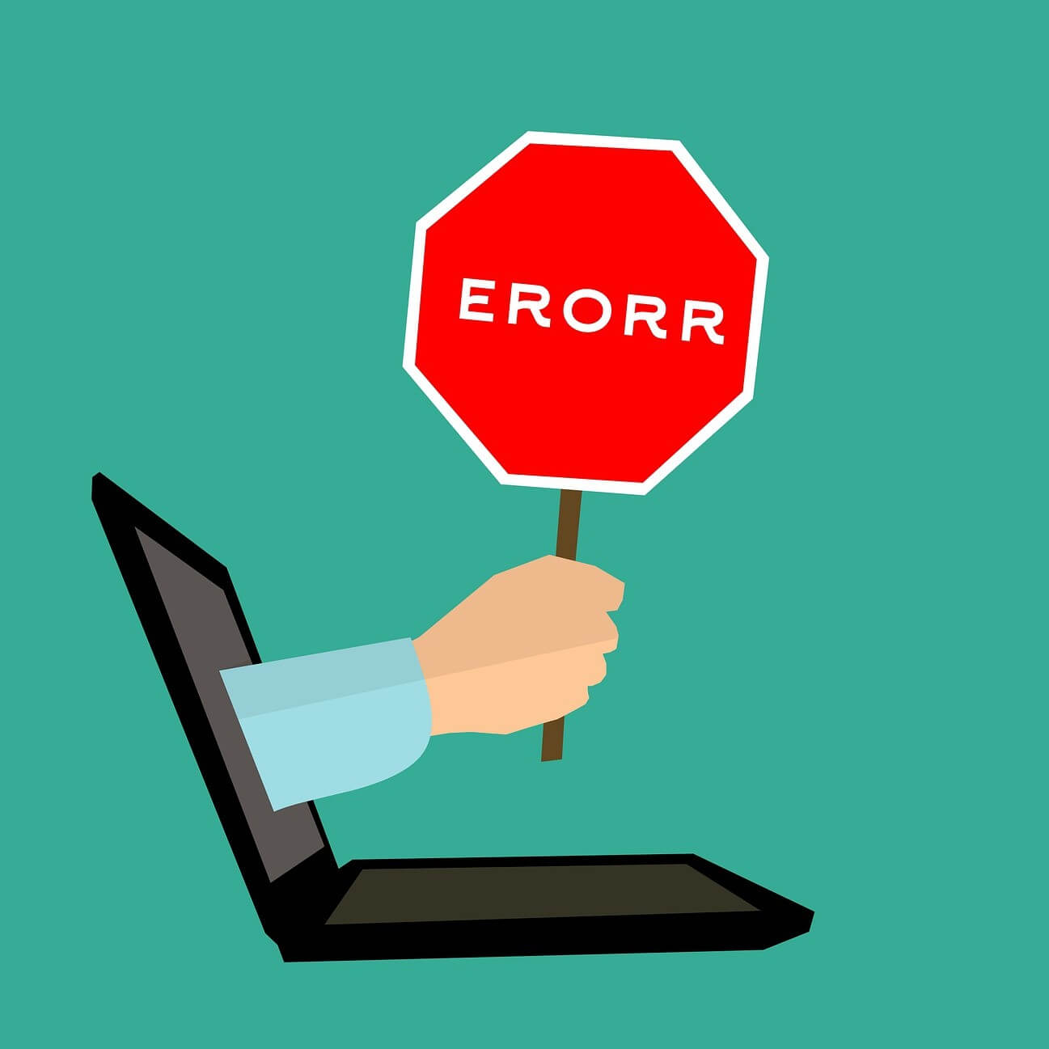


Slide 7
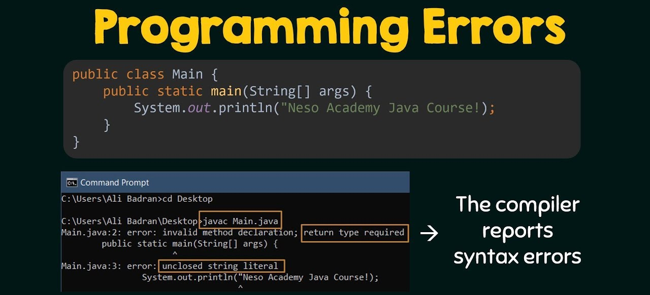
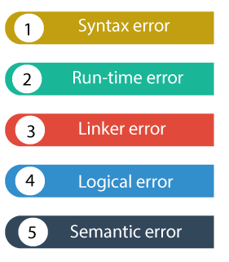

Slide 8
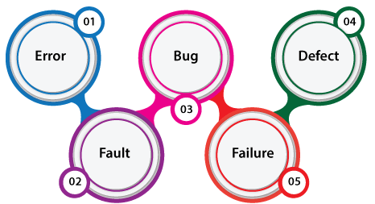

Slide 9
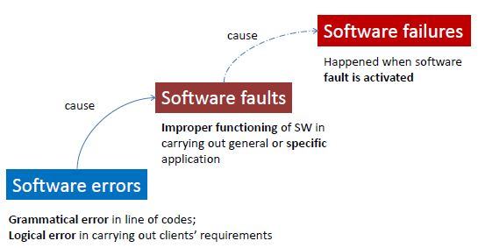

Slide 10

What is Software Testing?

Slide 11
Software Testing
A process of evaluating and verifying that a software product or application does what it is supposed to do.
Testing helps find errors.

Slide 12
Software Testing is a method to check whether the actual software product matches expected requirements and to ensure that software product is Defect free.

Slide 13
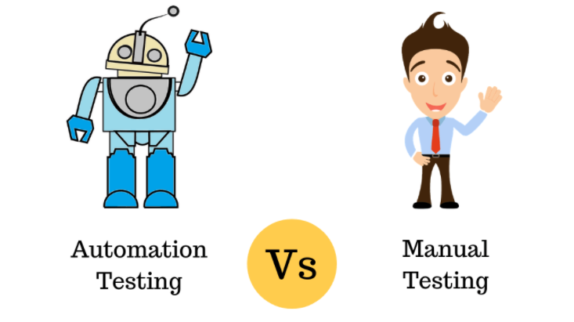
Software Testing Approaches

Slide 14
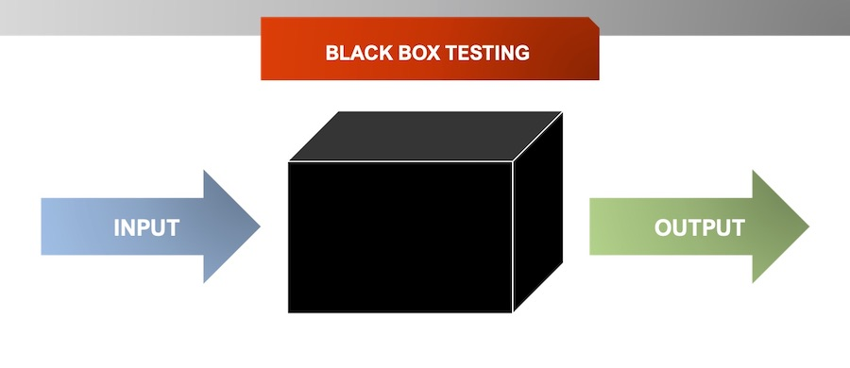
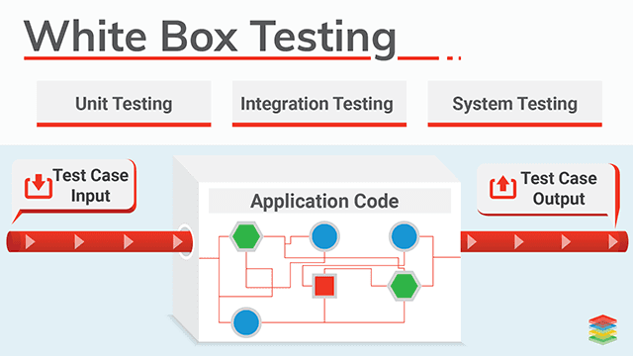
Types of Software Testing
Black Box Testing
White Box Testing

Slide 15
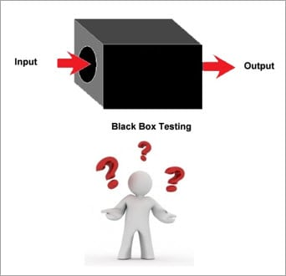
Why we say Black Box ?

Slide 16
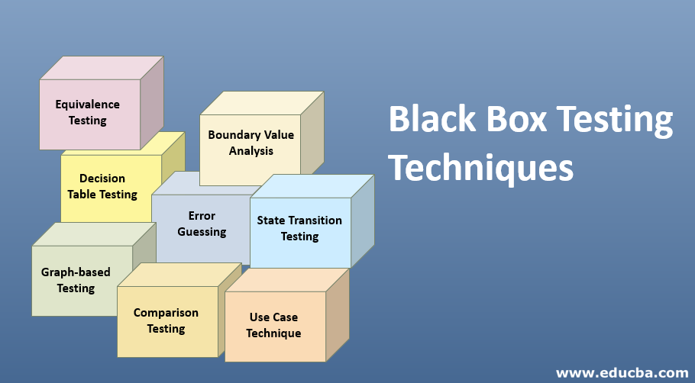

Slide 17
Black Box Testing Techniques
In order to systematically test a set of functions, it is necessary to design test cases. Testers can create test cases from the requirement specification document using the following Black Box Testing techniques.
Equivalence Partitioning
Boundary Value Analysis
Decision Table Testing
State Transition Testing
Error Guessing
Graph-Based Testing Methods
Comparison Testing

Slide 18
#1) Equivalence Partitioning
This technique is also known as Equivalence Class Partitioning (ECP).
In this technique, input values to the system or application are divided into different classes or groups based on its similarity in the outcome.
Hence, instead of using each and every input value we can now use any one value from the group/class to test the outcome.
In this way, we can maintain the test coverage while we can reduce a lot of rework and most importantly the time spent.

Slide 19
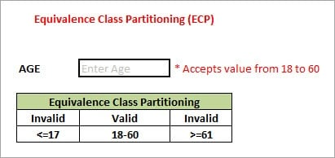
As present in the above image, an “AGE” text field accepts only the numbers from 18 to 60. There will be three sets of classes or groups.
Two invalid classes will be:
a) Less than or equal to 17.
b) Greater than or equal to 61.
One valid class will be anything between 18 to 60.
We have thus reduced the test cases to only 3 test cases based on the formed classes thereby covering all the possibilities. So, testing with any one value from each set of the class is sufficient to test the above scenario.

Slide 20
#2) Boundary Value Analysis
We focus on the values at boundaries as it is found that many applications have a high amount of issues on the boundaries.
Boundary means the values near the limit where the behavior of the system changes.
In boundary value analysis both the valid inputs and invalid inputs are being tested to verify the issues.

Slide 21
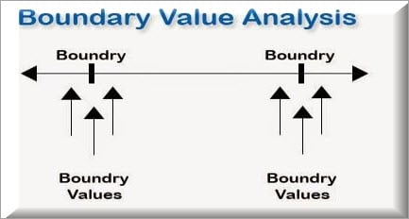
If we want to test a field where values from 1 to 100 should be accepted then we choose the boundary values: 1-1, 1, 1+1, 100-1, 100, and 100+1.
Instead of using all the values from 1 to 100, we just use 0, 1, 2, 99, 100, and 101.

Slide 22
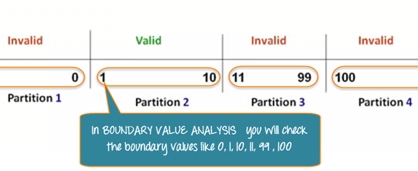

Slide 23
#3) Decision Table Testing
As the name itself suggests that, wherever there are logical relationships like:
If { (Condition = True) then action1 ; } else action2; /*(condition = False)*/
Then a tester will identify two outputs (action1 and action2) for two conditions (True and False).
So based on the probable scenarios a Decision table is carved to prepare a set of test cases.

Slide 24
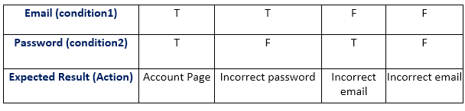
Decision Table Testing

Slide 25
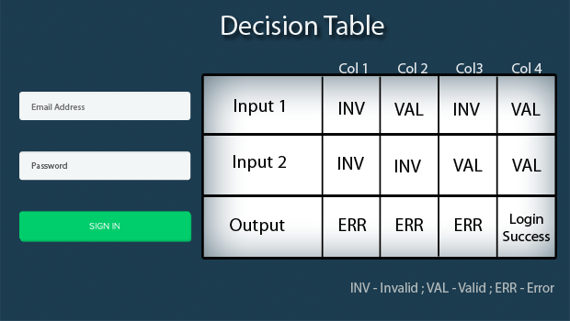

Slide 26
Errors, Faults and Failures in Software Applications

Slide 27


Slide 28
Categories of Software Errors:
User interface errors such as output errors or incorrect user messages.
Function errors
Hardware defects
Incorrect program version
Requirements errors
Design errors
Documentation errors
Architecture errors
Module interface errors
Performance errors
Boundary-related errors
Logic errors such as calculation errors, State-based behavior errors, Communication errors, Program structure errors, such as control-flow errors.

Slide 29
Why Test a software?
To Find faults
Prove that the software is correct
Demonstrate conformance to requirements
Reduce costs
Show system meets user needs
Assess the software quality
Build confidence

